Slide 1

MODY UNIVERSITY OF SCIENCE AND TECHNOLOGY
SCHOOL OF ENGINEERING AND TECHNOLOGY
MECHANICAL WORKSHOP
(ME 14.112)
SEMESTER-2
PROJECT BASED LEARNING-PHASE II
SUBMITTED TO –
DR. VIVEK PANDEY
SUBMITTED BY-
NIDHI CHOUDHARY (180074)
HARSHITA GARG (170401)
HIRAL JAIN (180167)
AKSHITA KANTHER (180161)
SIMRAN JAIN (180181)

Slide 2

WOODEN LAMP

Slide 3
CONTENTS
Introduction to carpentry
Types of Wood
Carpentry Tools
Carpentry joints
Carpentry Operations
Wooden Lamp Light
Materials and tools required
Detailed designing
Carpentry operations to be performed while making the model
Advantages
Applications
Precautions

Slide 4
INTRODUCTION
Carpentry may be defined as the process of making
wooden components. It starts from a marketable form of
wood and ends with a finished product. It deals with the
Building work, furniture, cabinet marking etc., joinery,
i.e. preparation of joints are one of the important operations
in all wood works. It deals with the specific work of a
Carpenter like making different types of joint to form a
Finished product.

Slide 5
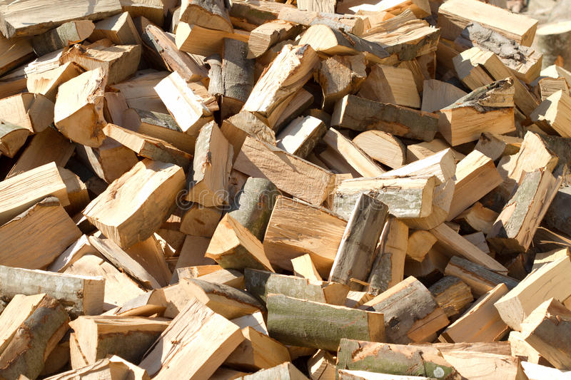
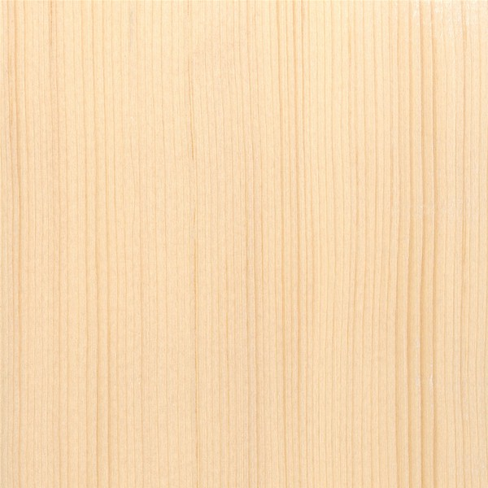
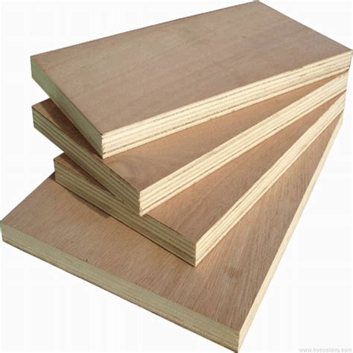
TYPES OF WOOD
Hard Wood
Soft Wood
Ply Wood

Slide 6
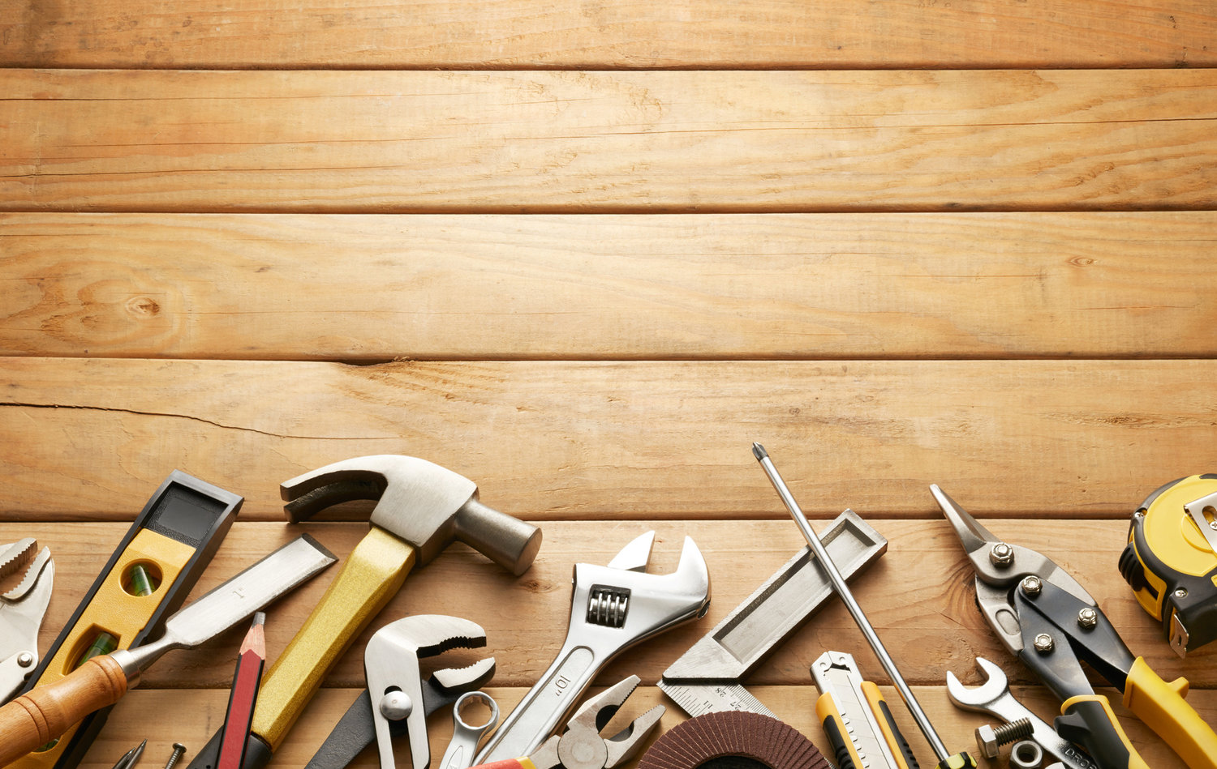
CARPENTRY
TOOLS

Slide 7
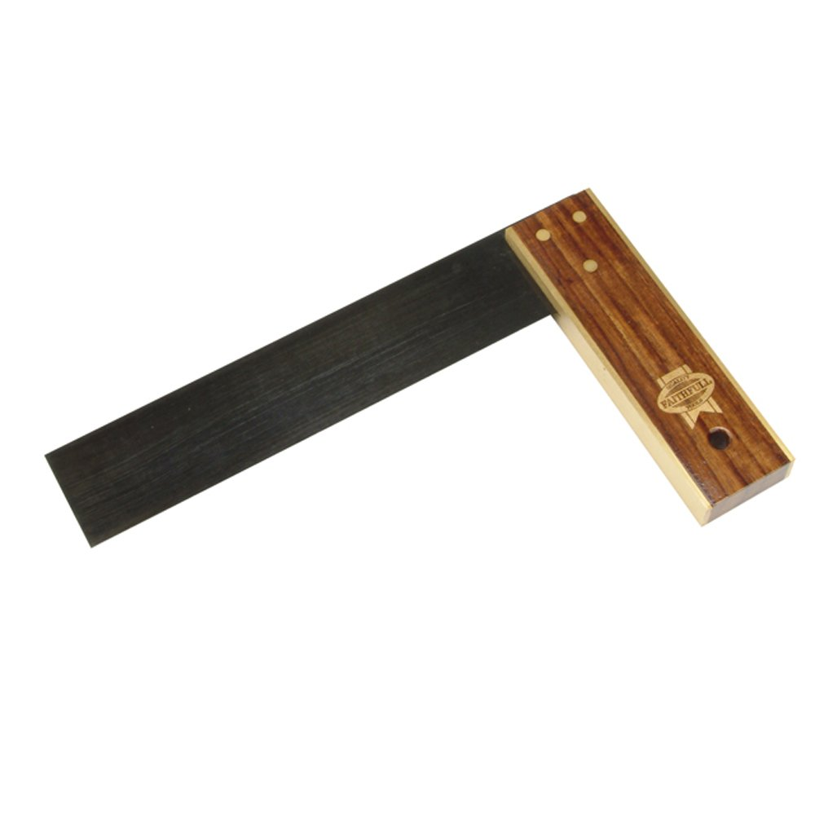
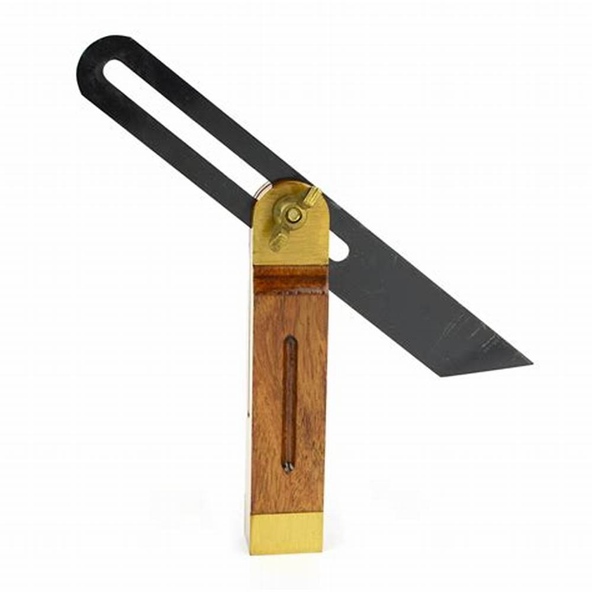
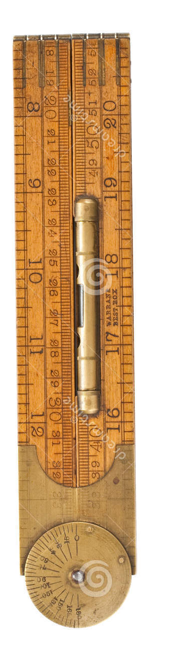
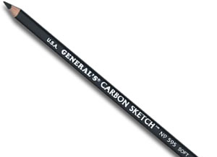
Marking and Measuring Tools
TRY SQUARE
BEVEL SQUARE
CARPENTER’S FOLDING RULE
CARBON PENCIL

Slide 8
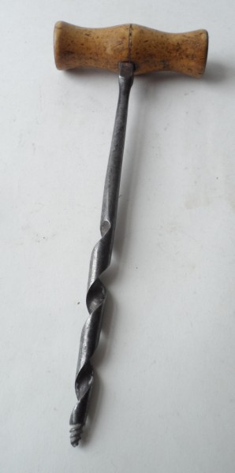
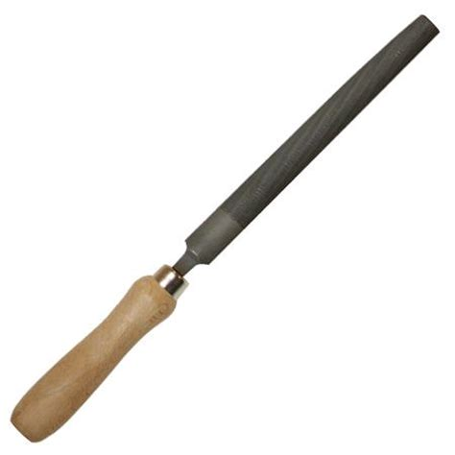
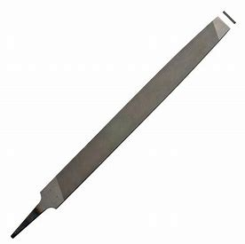
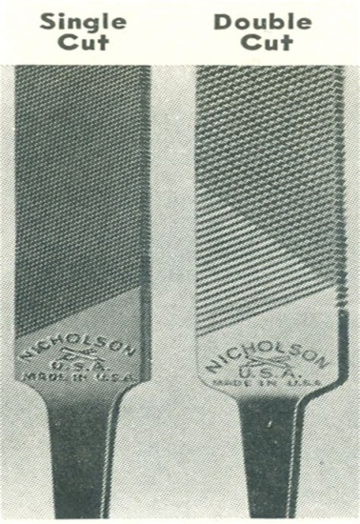
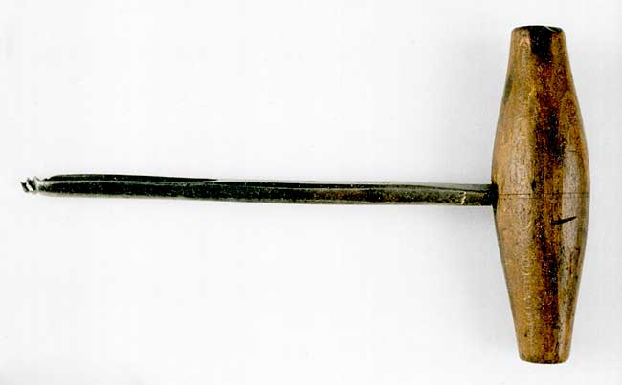
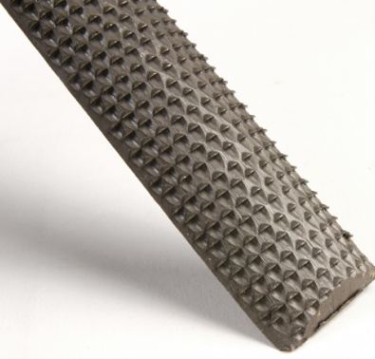
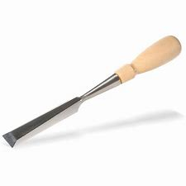
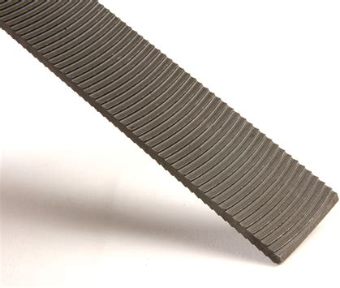
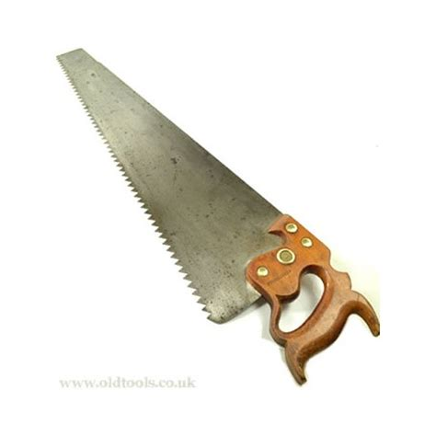
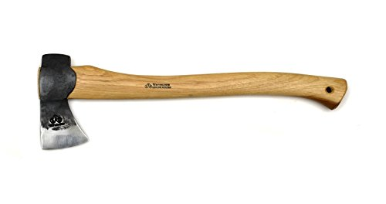
Cutting Tools
TWISTED GIMLET
BASTARD FILE
HALF ROUND FILE
SINGLE CUT & DOUBLE CUT FILE
PLAIN GIMLET
CHISEL
RASP CUT FILE
CURVED TOOTH FILE
AXE
RIP SAW

Slide 9
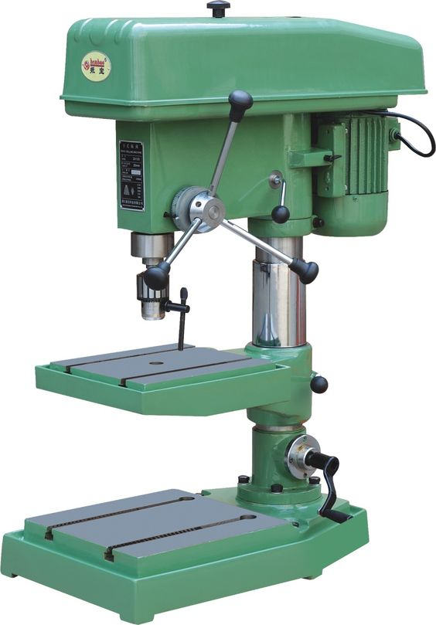
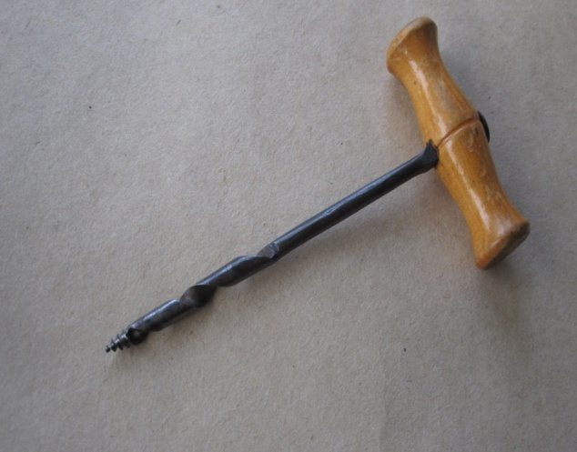
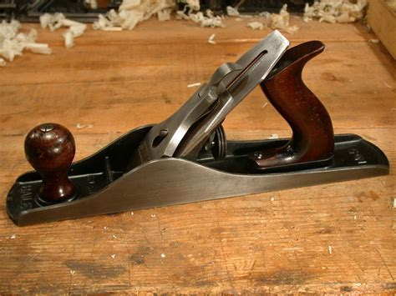
Drilling Tools
GIMLET DRILL
DRILLING MACHINE
Planing Tools
WOODEN OR METALLIC JACKPLANE

Slide 10
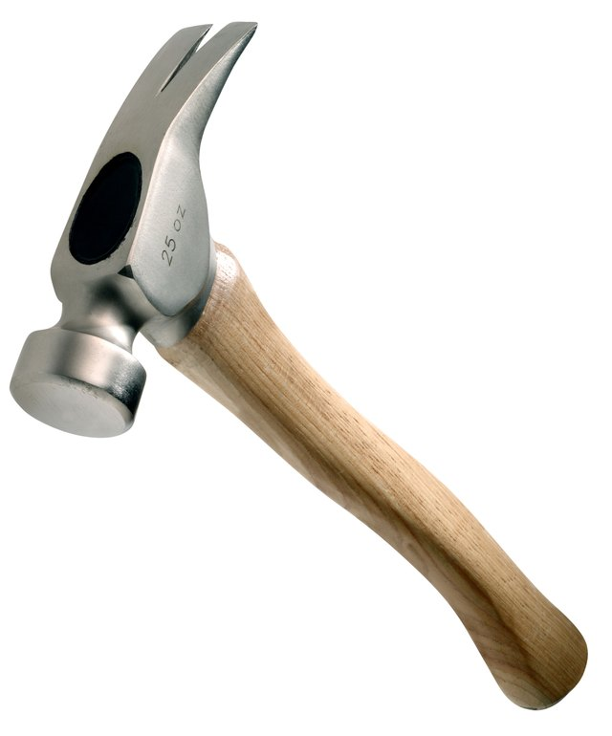
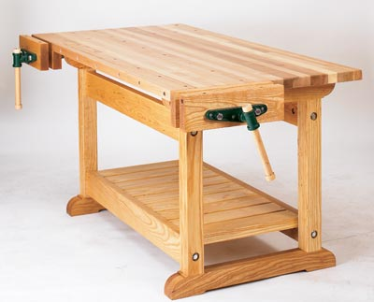
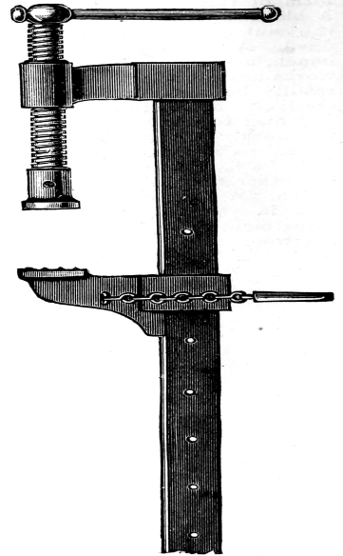
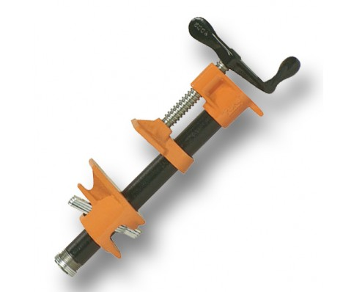
Striking Tools
Clamping Device
CLAW HAMMER
CARPENTER’S BENCH
BAR CLAMP
SASH CLAMP

Slide 11

CARPENTRY
JOINTS

Slide 12
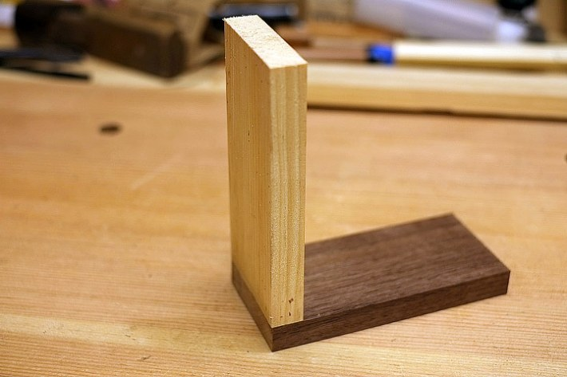
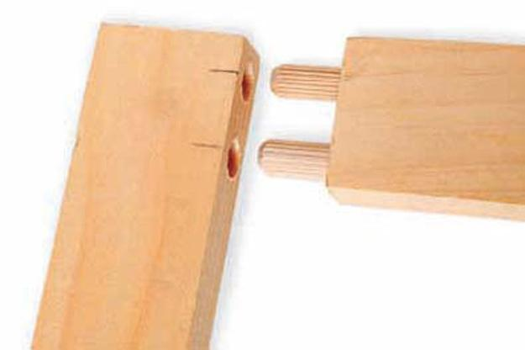
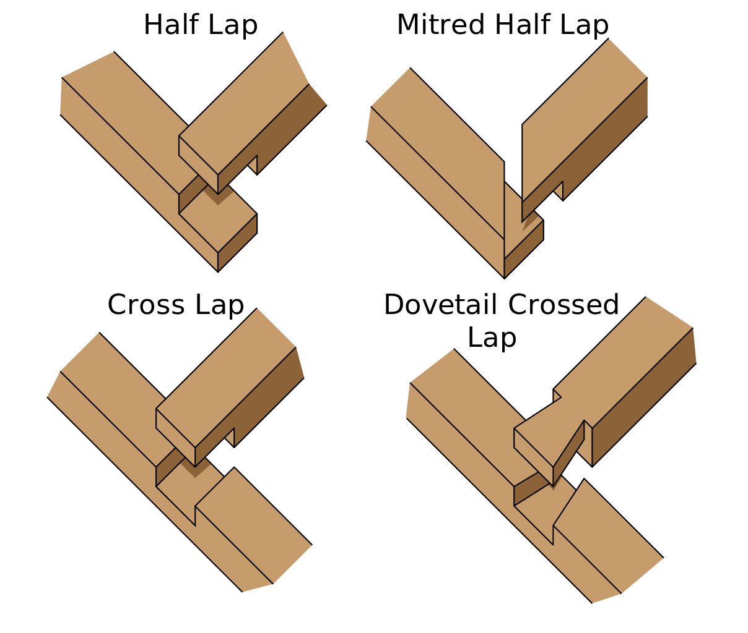
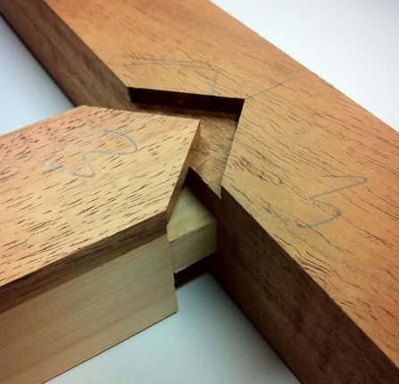
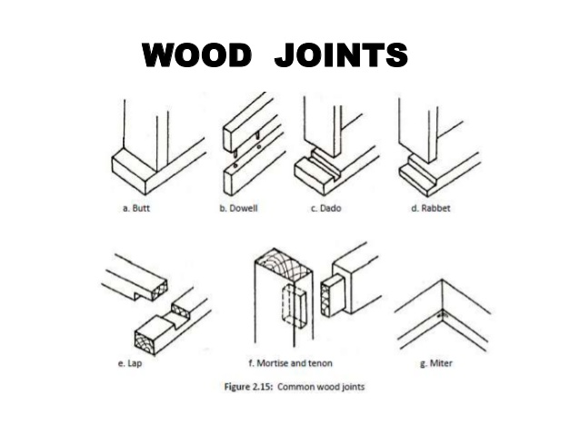
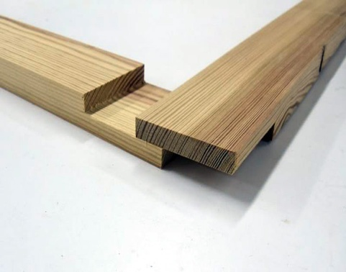
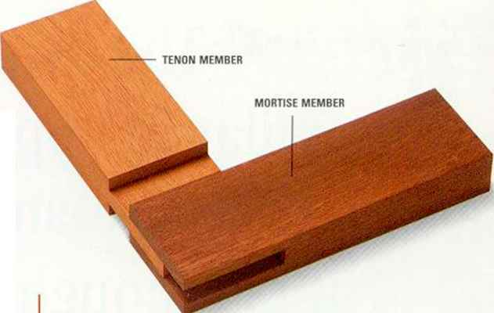
BUTT JOINT
DOWEL PIN JOINT
CROSS LAP JOINT
FEATHER JOINT
LAP JOINT
BRIDDLE JOINT
CORNER LAP JOINT

Slide 13

CARPENTRY OPERATIONS
Marking and Measuring
Sawing
Planning
Chiselling
Boring
Grooving
Moulding
Seasoning
Rebating
Recessing

Slide 14
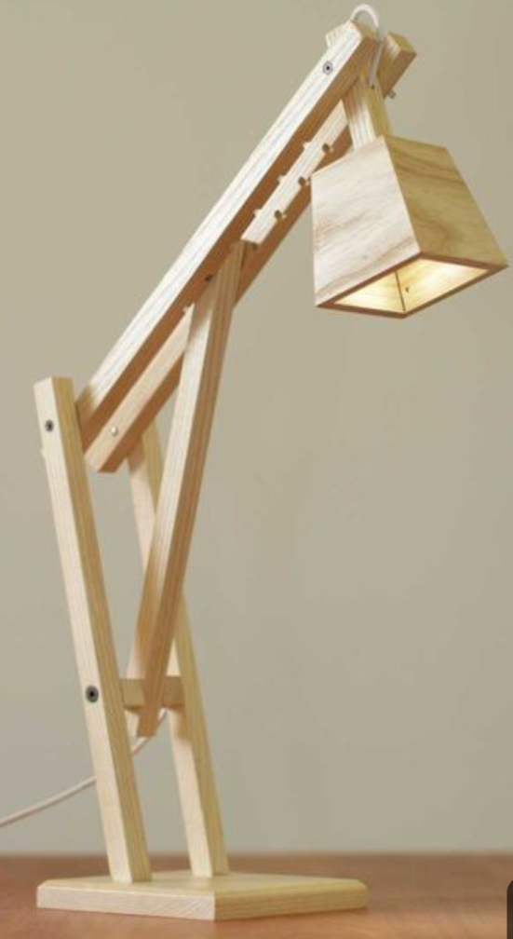
Introduction to Wooden Lamp
We are preparing a wooden lamp light using various carpentry operations ,tools and joints.
It’s construction is very easy . It is will be a multipurpose lamp as it will have numerous applications.

Slide 15
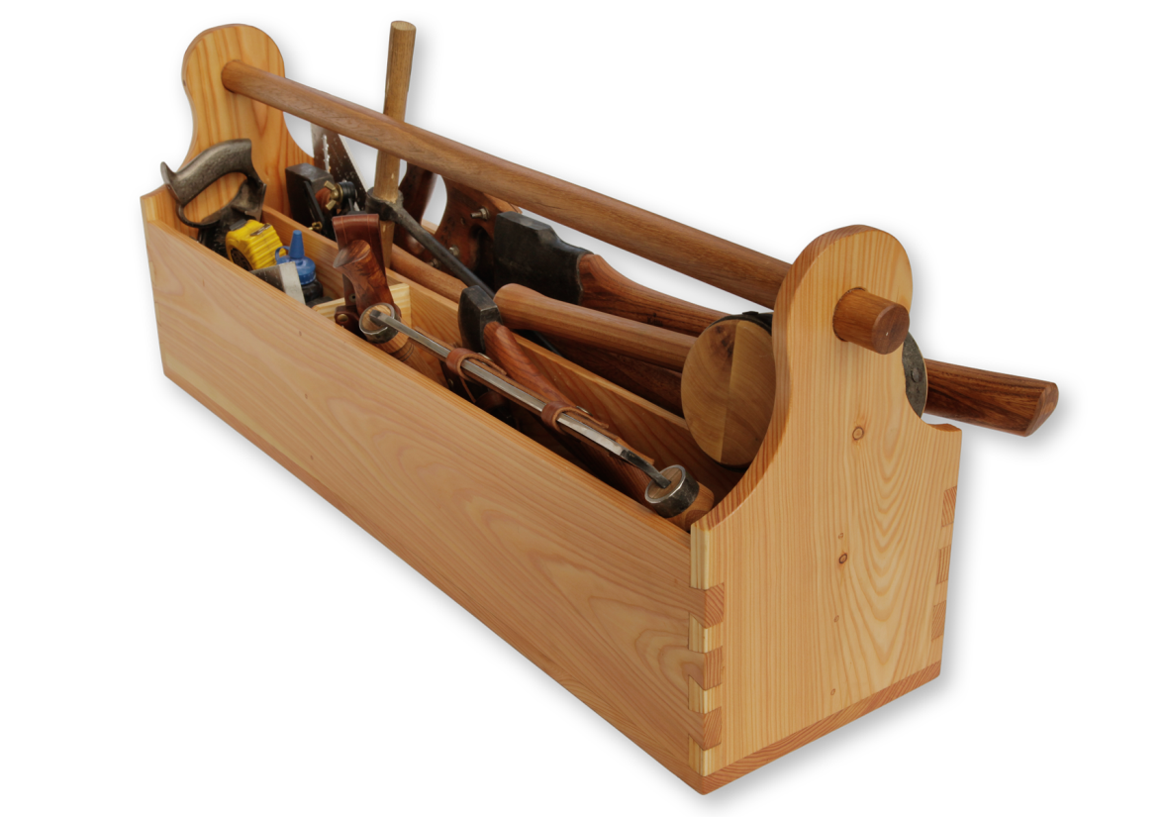
MATERIALS REQUIRED-
Soft wood ,ply wood, 1LED, nails , screws, nuts, bolts, nails wire and supply(230V , 50Hz),glue(fevicol).
TOOLS REQUIRED-
Steel rule
Marker
Ripsaw
Metal jackplane
Try square
Bevel square
Drilling machine
Hammer
Rasp file
Sash clamp
Chisel

Slide 16
Detailed Designing
MATERIALS REQUIRED-
1. Ply wood- 4 wooden plates(170×140 ×5)mm³
2. Ply wood- 1 wooden plate(125x125x13)mm³
3. Soft wood- 1 wooden planck(88x22x12)mm³
4. Soft wood- 2 wooden plancks(330x24x16)mm³
5. Soft wood- 2 wooden plancks(382x30x16)mm³
6. Ply wood- 1 wooden plate(158x121x13)mm³
7. Hard wood- 1 wooden plate(122x234x25)mm³
8. 1 LED- 8W
9. 1 nut and bolt of diameter 8mm and 4.5 inch long
10. 2 nuts and bolts of diameter 5mm and 2 inch long
11.wire, LED and holder
12. Fevicol
13. nails

Slide 17
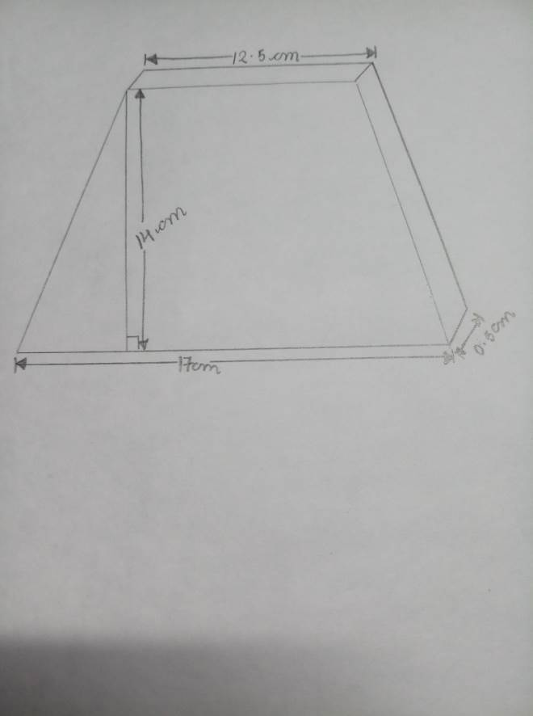
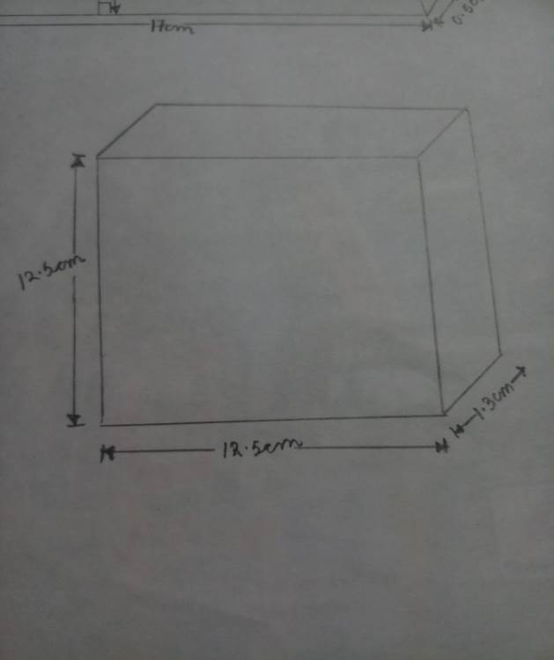
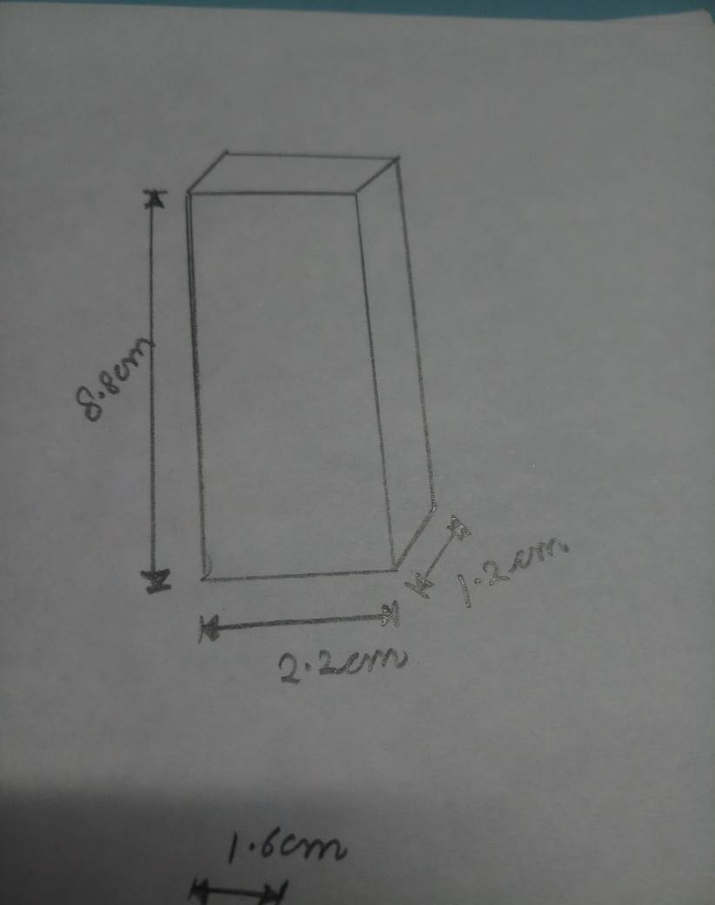
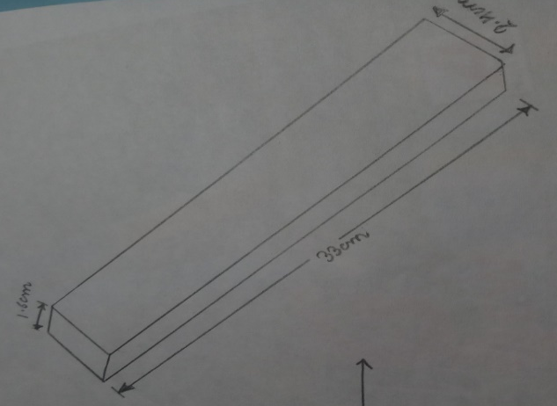
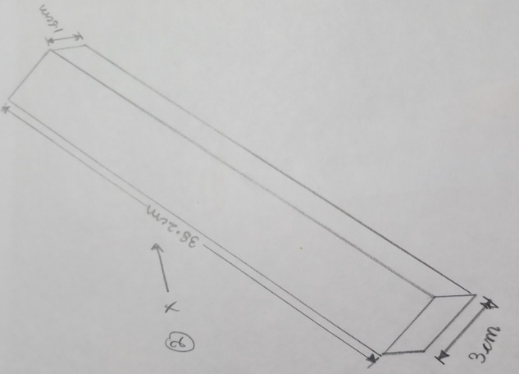
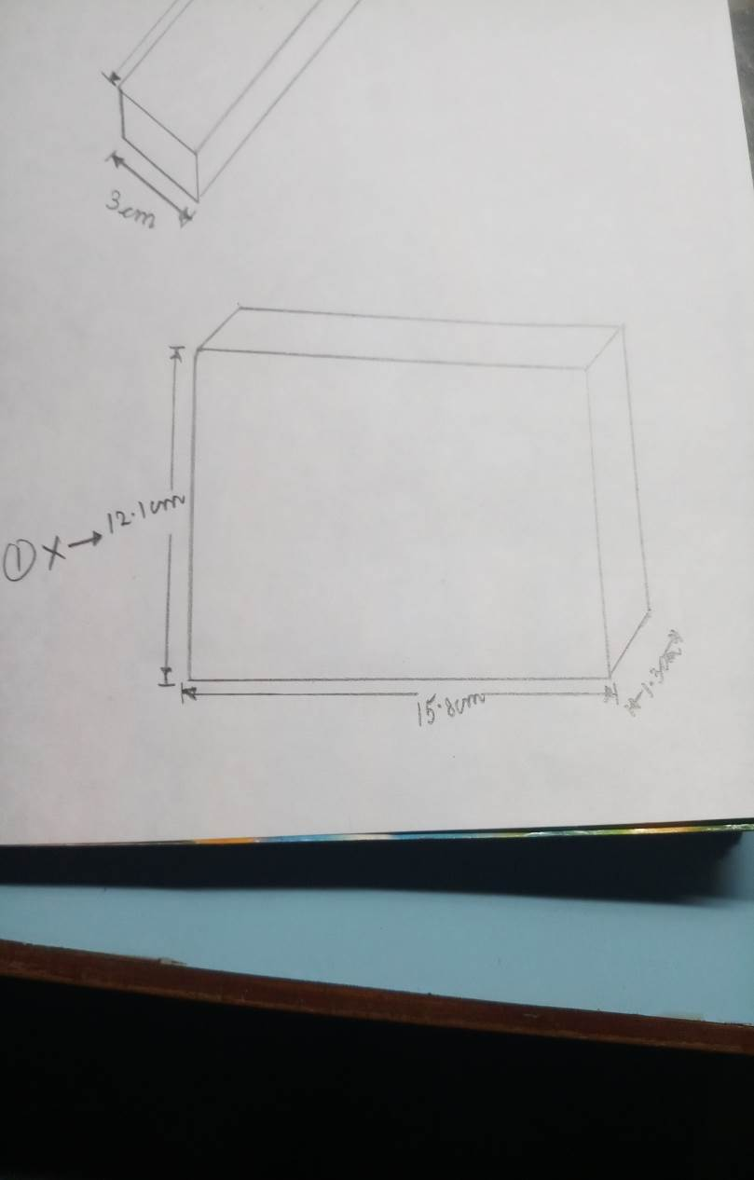
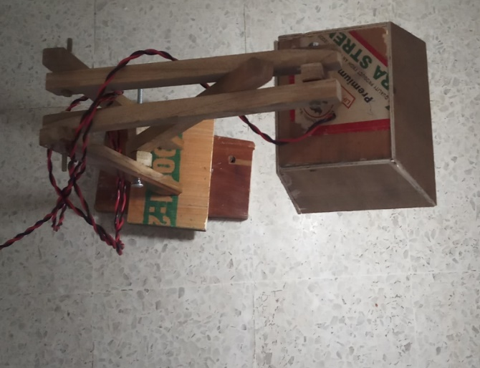
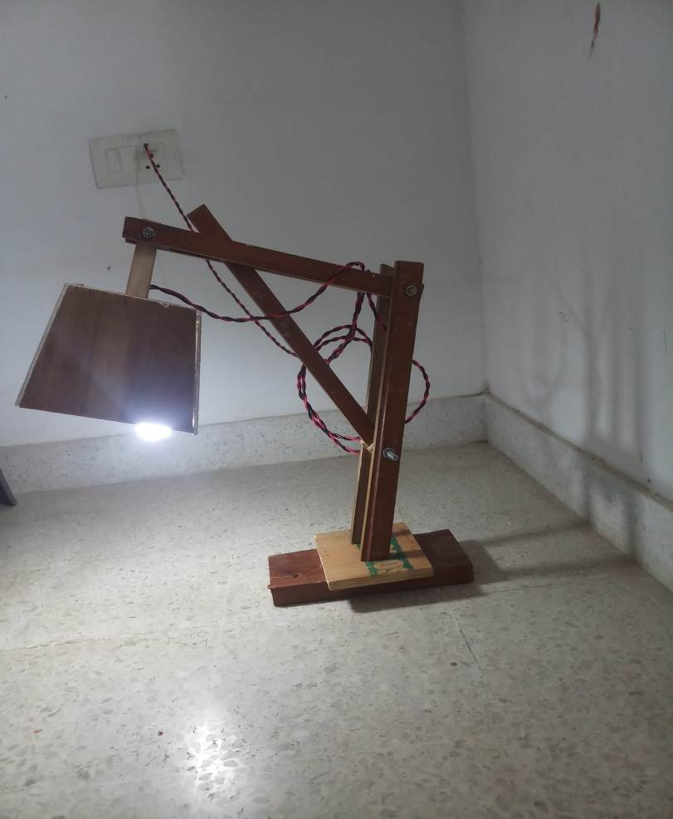
Fig. (2.1)
Fig.(2.2)
Fig.(2.3)
Fig.(2.4)
Fig.(2.5) Fig.(2.6)
Fig(2.7) Top view of Wooden Lamp
Fig(2.8) Side view of Wooden Lamp

Slide 18
CARPENTRY OPERATIONS (which will be used in the model)-
In carpentry, a large number of operations are carried out to give a finish to work piece . Different operations which will be performed in making our model are broadly classified below:-
Marking- Marking is a process of setting out dimensions on wooden pieces to required shape. Marking and measuring operations are carried out collectively on a different pieces of wood to set out the dimensions mentioned previously.
Sawing-This operation is carried out for cutting wood to required size and shape (which is straight, inclined or curved). The wooden pieces (slabs and plates) are first fixed in a vice and wood is moved up as sawing proceeds.
Planning-It is done for obtaining a perfectly smooth dimensionally true surface with the application of a suitable planer. The surfaces of all plates and slabs are made perfectly straight and parallel in width and all edges square to the face except the lamp plates, they are made in trapezium shape.

Slide 19

4. Drilling- It is an operation done to make round/cylindrical holes in wood. Drilling will be done on the top of lamp for insertion of wire and also for woodworking.
5.Chiselling-It is an operation of cutting a small stock of wood for
producing desired shapes.
With the help of chiseling, we will remove extra material from the
work pieces.
6.Hammering-After cutting all the wooden slabs and plates in the
required shape, we will join all of them using hammer and
nails as per the given figure[5.1].
After then LED will be fixed with the help of screws and bolts and
the wire will be connected to switchboard to give supply to the LED.
And finally our model is ready.
Fig[5.1]
Structure of wooden lamp

Slide 20

Advantages-
USE OF LED :As compared to bulbs and tube light L.E.D’s are more efficient , saves the energy , lowers the electricity bill.
EASY TO MAKE
MATERIALS EASILY AVAILABLE
DOESN’T TAKE MUCH TIME
MULTIPURPOSE

Slide 21

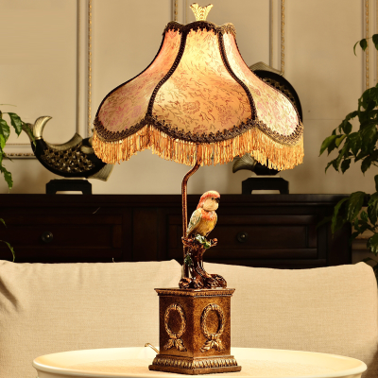
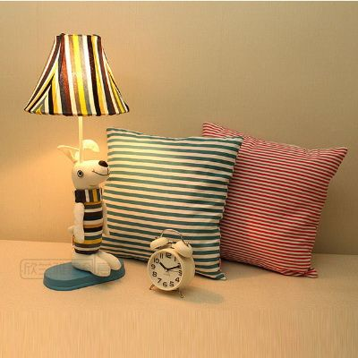
Applications-
This wooden lamp can be used for various purposes such as :
Study Lamp
Home(for decoration and illuminating purposes)
Restaurants
Hotels

Slide 22
Precautions-
Wear The Right Clothes- The problem with wearing baggy or loose clothes is the very high chance that a part of them might get caught in a cutting head or saw blade. As a result, try to always wear clothes that you are a better match for the woodworking environment, but also protect you. Also always ensure that any dangling jewelry or metal such as chains or bracelets, are removed before commencing work.
Never Use Blunt Blades & Bits- While this might seem obvious seeing as how dangerous a dull cutting tool can be. Dull tools will need to be made to work harder to cut and as a result can bind or kick back. Sharp bits and blades will ensure cleaner cuts as well.

Slide 23
3. Work Against The Cutter Most power tools are built in a way that requires the direction a piece of wood moves through the tool, is the opposite direction of the cutting head’s movement. So you need to ensure that the blade or router bit cuts against the motion of the wood instead of with it.
The wooden should not be fed to the sewing machines faster than the cutting speed of the machine.
One should not use defective or damaged carpentry tools and machines while carrying out work in carpentry shop.
No carpentry tools should be thrown for saving time in handling.
7. Nails, screws should be properly kept in a box for proper house keeping.

Slide 24


